Slide 1
Efficient FPGA Modular Multiplication Implementation
汇报人：潘承愿
Jun 24, 2021

Slide 2
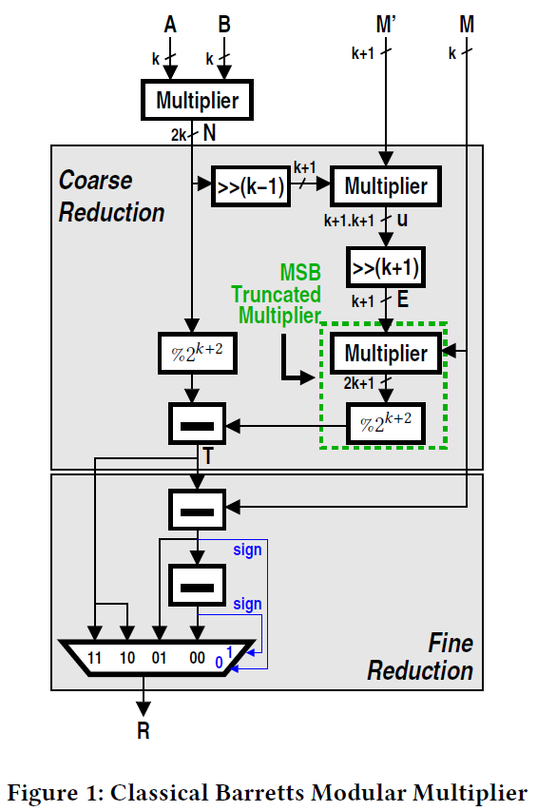
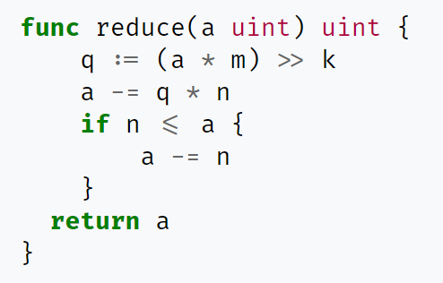




Classical Barrett's Modular Multiplier
m
n
$$a mod n=a −n×\left\lfloor \frac{a}{n} \right\rfloor$$
a
$$\frac{1}{n} ← \frac{m}{2^{k}} ⟹a mod n=a −n×\left\lfloor \left(a×m\right)≫k\right\rfloor$$
$$m ← \left\lfloor \frac{n}{2^{k}}\right\rfloor$$
offline
$$[0, 2n)$$

Slide 3



Classical Barrett's Modular Multiplier
Target:
$$R=AB mod M=N mod M$$
$$2^{k−1}<M<2^{k}$$
$M^{′}=\left\lfloor \frac{2^{2k}}{M}\right\rfloor$, k+1 bits
$u=M^{′}× \left\lfloor \frac{N}{2^{k−1}}\right\rfloor$, 2k+2 bits
$E=\left\lfloor \frac{u}{2^{k+1}}\right\rfloor$, k+1 bits
$P=EM$, 2k+1 bits
$T=N−P,T∈[0, 3M)$

Slide 4
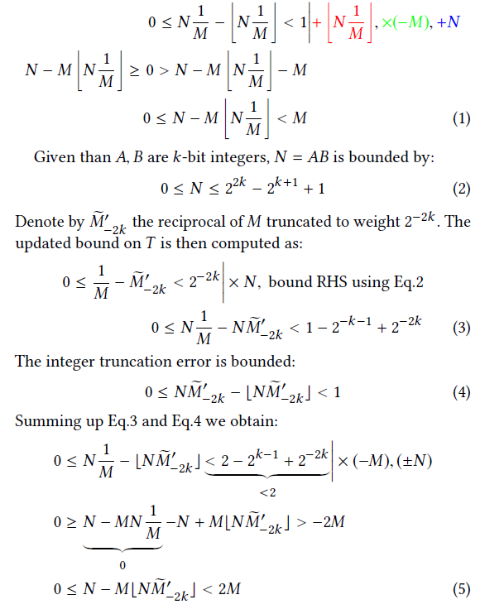
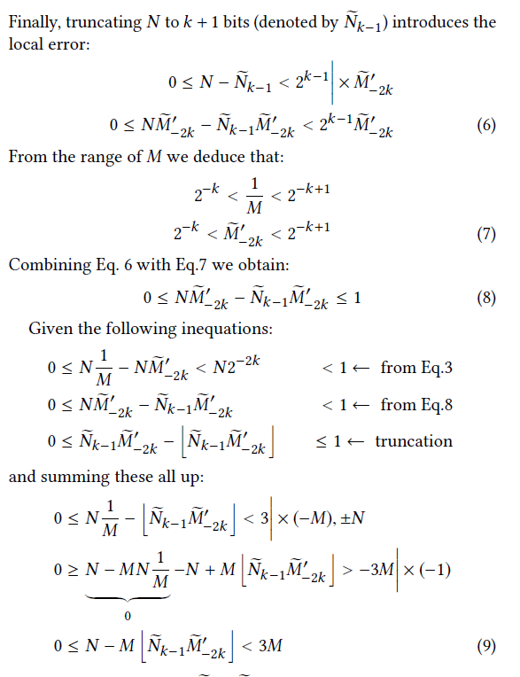
Classical Barrett's Modular Multiplier
Target:
$$R=AB mod M=N mod M$$
$$2^{k−1}<M<2^{k}$$

Slide 5
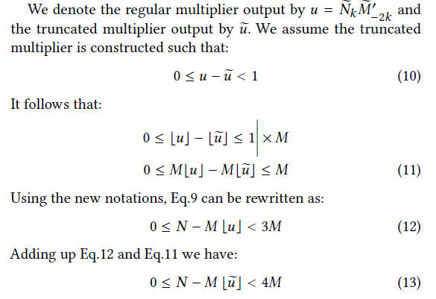
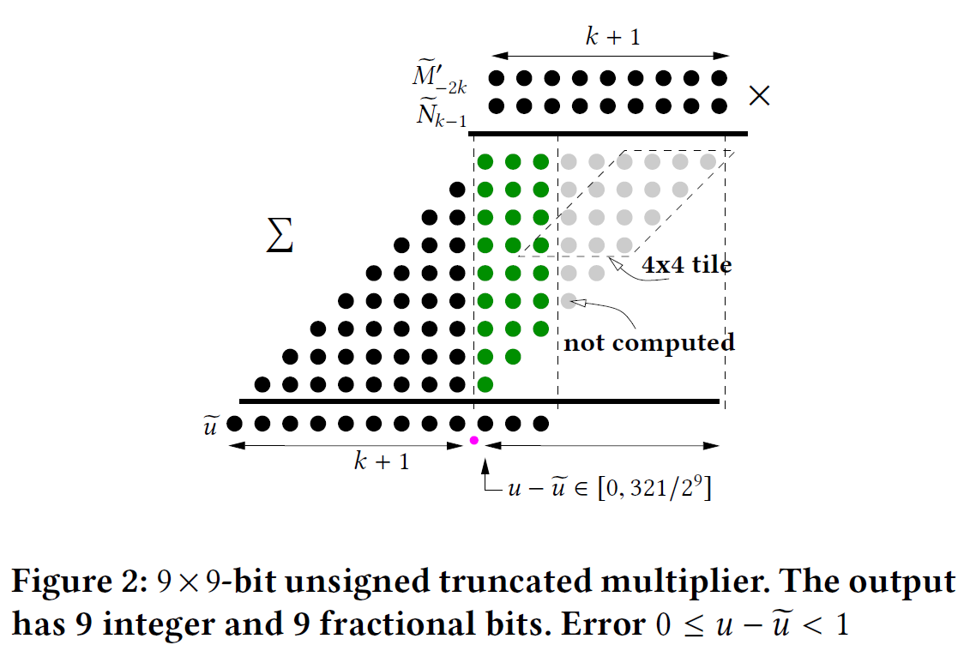
Classical Barrett's Modular Multiplier
Target:
$$R=AB mod M=N mod M$$
$$2^{k−1}<M<2^{k}$$

Slide 6
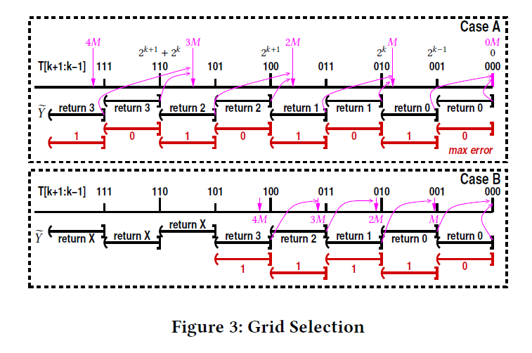

New Fine Reduction Circuit
$$T−YM∈\left[0, M\right), Y= ?$$
k+1 k k-1 …
0M=0 0 0 x x x …
1M=0 0 1 x x x …
2M=0 1 1 x x x …
3M=1 0 1 x x x …
4M=1 1 1 x x x …

Slide 7
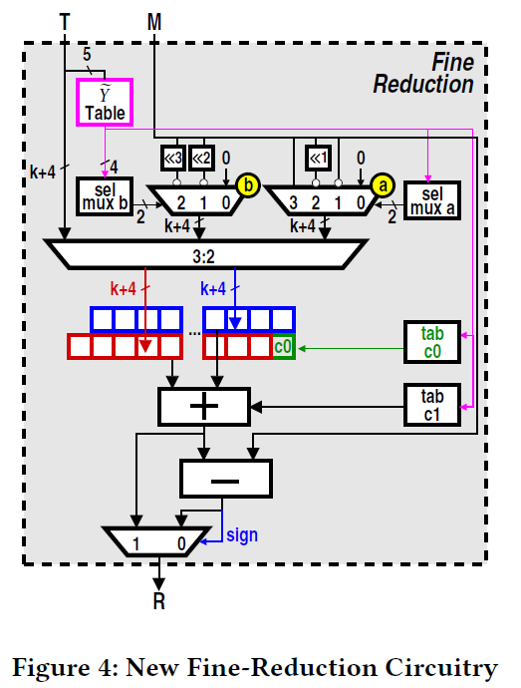
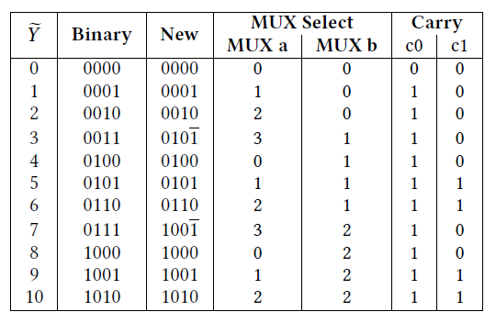
New Fine Reduction Circuit

Slide 8
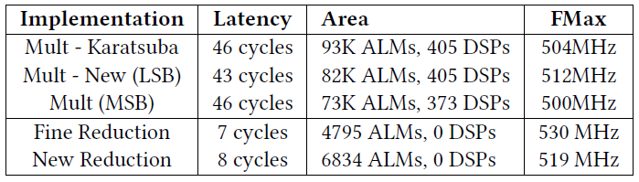
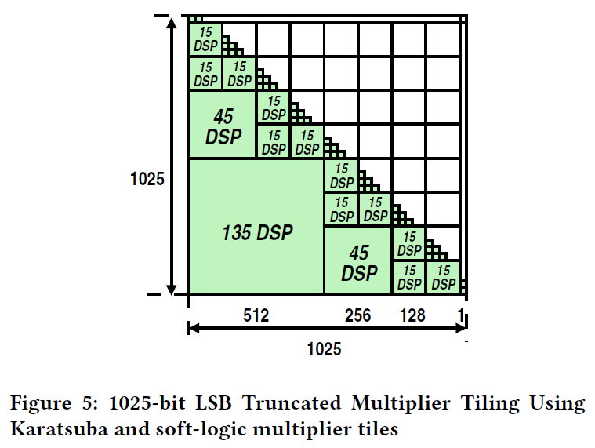
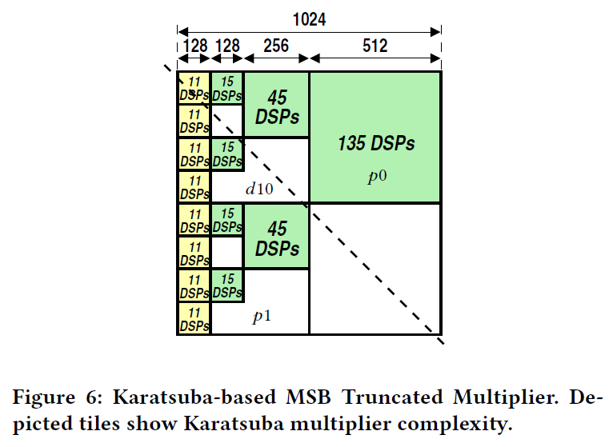
Result
Karatsuba

Slide 9
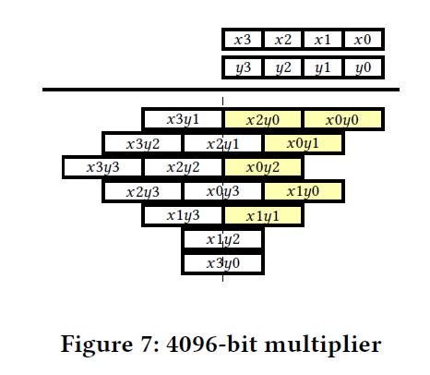
Result
up to 3b LSB error

Slide 10
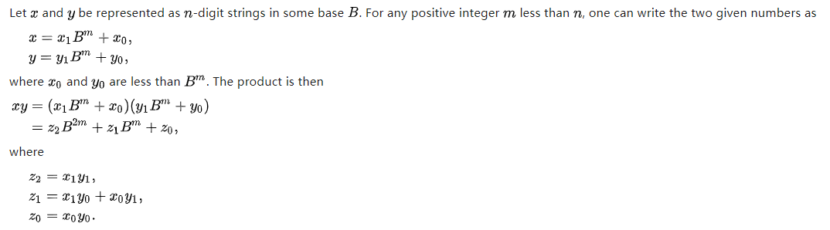

Karatsuba Algorithm

Slide 11
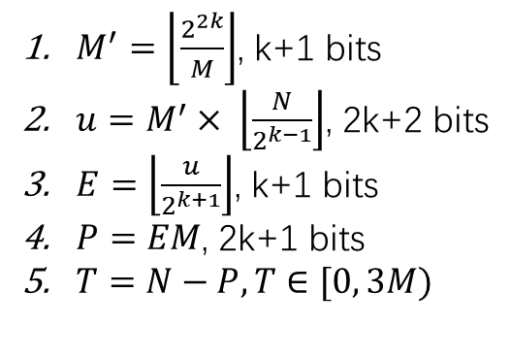
$M^{′}=\left\lfloor \frac{2^{2k}}{M}\right\rfloor$, k+1 bits
$u=M^{′}× \left\lfloor \frac{N}{2^{k−1}}\right\rfloor$, 2k+2 bits
$E=\left\lfloor \frac{u}{2^{k+1}}\right\rfloor$, k+1 bits
$P=EM$, 2k+1 bits
$T=N−P,T∈[0, 3M)$

Slide 12
$M^{′}=\left\lfloor \frac{2^{2k}}{M}\right\rfloor$, k+1 bits
$u=M^{′}× \left\lfloor \frac{N}{2^{k−1}}\right\rfloor$, 2k+2 bits
$E=\left\lfloor \frac{u}{2^{k+1}}\right\rfloor$, k+1 bits
$P=EM$, 2k+1 bits
$T=N−P,T∈[0, 3M)$

